Slide 1


Slide 2
In case of emergency
NHS App & demo
Ask questions
Future topics
Update on PC buying - Andy
Tea, coffee biscuits
After tea break:
Helpers help you
Next session:
Tue 24 June 2025, 10am intermediate topic
Alister explains all about
Flight simulators
The NHS App
Ken Surplice, u3a Computer Group

Slide 3
The NHS App
Learn, laugh, live ​
June 2025
Ken Surplice
u3a Computer Group Basingstoke - Old Basing

Slide 4
The NHS App
Helping people to stay well, get well and manage their health ​

Slide 5
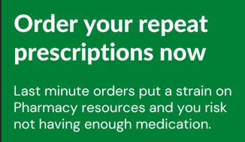
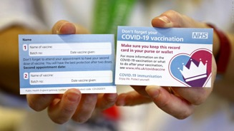
Why look at the NHS app?
Elaine, ex u3a business secretary:
Practice closed.
Computer problem

Slide 6
Quiz time
Who wrote the NHS app?
The NHS (NHS Digital)
When was it released?
2018
How can you access it?
Phone or tablet
Web via NHS web site

Slide 7
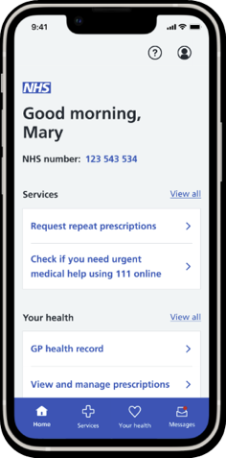
The NHS App
Owned and run by the NHS, the NHS App enables people to access digital health and care services
It’s available to anyone 13 years and over, who is registered with an NHS GP practice in England or the Isle of Man
It's a safe and simple way to access a range of NHS services on your smartphone or tablet - anytime, anywhere
All NHS App services can also be accessed online, through the NHS website
New and improved
After extensive user testing, the NHS App has undergone a recent redesign to make it even more user friendly and easier to navigate.
Download the NHS App for yourself: https://www.nhs.uk/nhs-app/

Slide 8
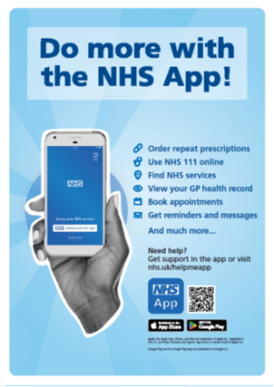
Why use the NHS App?
*The features available to you depend on what has been enabled by your local area
The NHS App helps you to*:
Get Well
Find NHS services near you
Use NHS 111 online
Book GP appointments
Manage your secondary care appointments
Contact your GP surgery using an online form
Stay Well
View your prescription details
Order repeat prescriptions and nominate a pharmacy
Book a COVID or Flu vaccine
Receive secure messages from your GP and healthcare providers
Search Health A-Z
Manage Your Health
View your health record
View test results
View your NHS number
Register for a GP online
Make an organ donation decision
Link accounts to help manage the health care of someone you care for
Protect the NHS
It saves money by improving access to NHS services, lowering administrative and SMS messaging costs
It makes it easier for patients to digitally access services, helping patients receive the best care and supporting healthcare professionals to deliver it

Slide 9
Quiz time
Is it popular?
End 2023 33.6 million registered
Who can use the NHS app?
>13 years old
GP in England or Isle of Man
How busy?
15,762 logins each month
67% of GP-registered patients

Slide 10
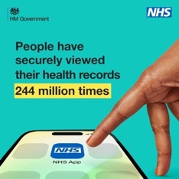
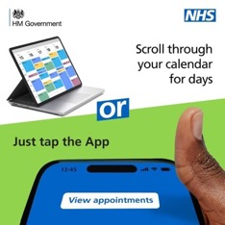
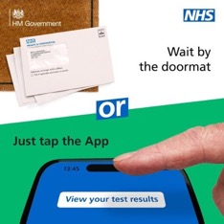
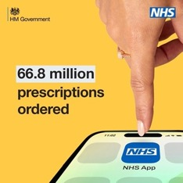
National promotion campaign
'Tap the App'
NHS England has launched a campaign to encourage greater use of the NHS App. ​
It shows how to conveniently access essential health and care services you simply need to ‘tap the App’. ​

Slide 11
Quiz time
Is my data safe on my phone?
Data is not stored on your phone
Can you check hospital waiting lists & times?
Yes
Can you choose where prescriptions are sent?
Yes

Slide 12
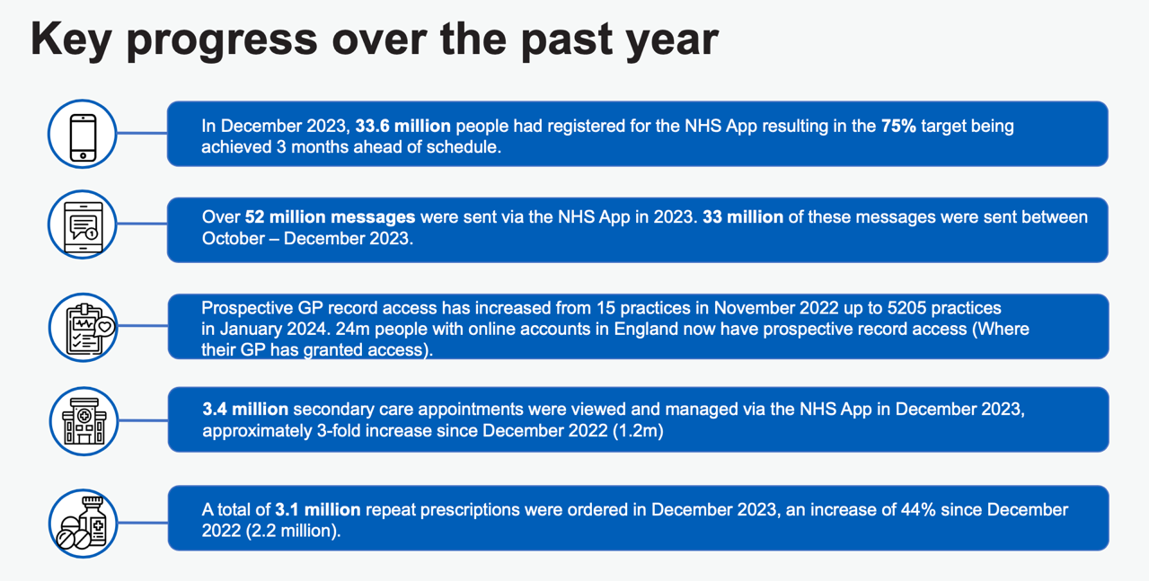

Slide 13
Tutorials
Register
GP record
Prescriptions
NHS services
Helping others
111 online

Slide 14
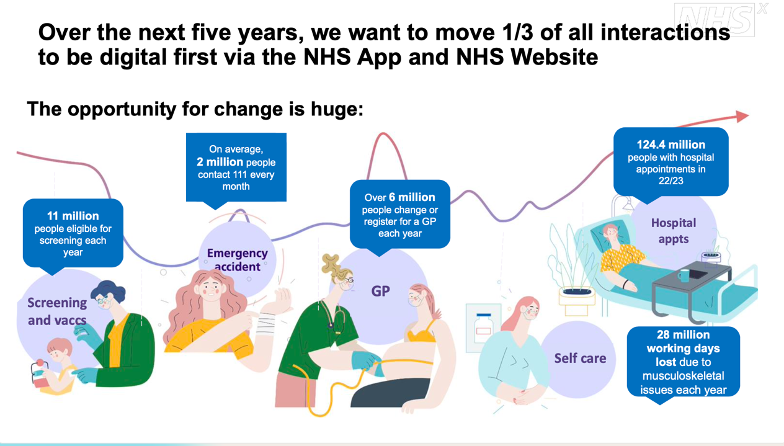

Slide 15
Quiz time
Can I choose whether to be an organ donor?
Yes
Can I book a vaccination?
Yes
Who has more users, NHS app or Netflix?
App = 2x Netflix

Slide 16
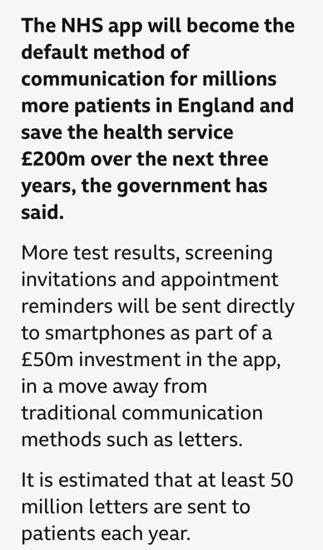
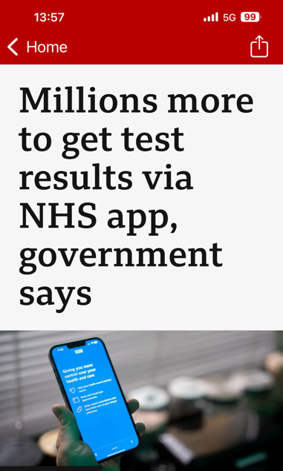

Slide 17
What do I do now?
Ensure you are registered
Have a look around the app
Check back occasionally
to see what's new

Slide 19
Upcoming topics
Flight simulators
Master your passwords
Mastering Word
Photo and video editing
Organising files and photos
Home networking
Favourite tips

